Slide 1
Pulmonary embolism
Dr. B. NAGA MALLI KUMAR
M.D.,DNB PULMONARY MEDICINE

Slide 2
definition
A pulmonary embolism is a blood clot in the lung that occurs when a clot in another part of the body (often the leg or arm) moves through the bloodstream and becomes lodged in theblood vessels of the lung, lowers oxygen levels in the lungs and increases blood pressure in the pulmonary arteries.

Slide 3
PATHOPHYSIOLOGY
Inflammation and Platelet Activation by Virchow’s triad of venous stasis, hypercoagulability, and endothelial injury
Prothrombotic States -
factor V Leiden mutation
Deficiency of Antithrombin, protein C, and protein S
Antiphospholipid antibody syndrome
Embolization

Slide 4
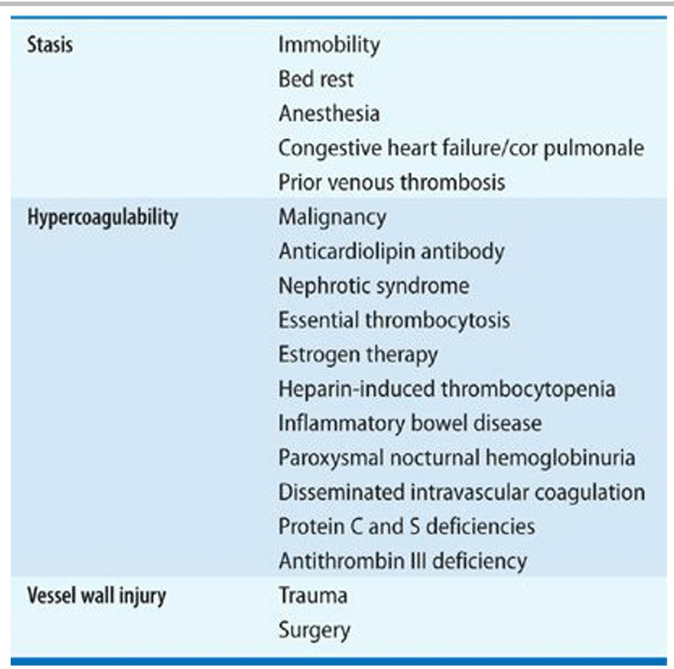
Risk factors based on Virchow’s triad

Slide 5
Predisposing factors for venous thromboembolism
Strong risk factors
Fracture of lower limb
Hospitalization for heart failure or atrial fibrillation/flutter
(within previous 3 months)
Hip or knee replacement
Major trauma
Myocardial infarction (within previous 3 months)
Previous VTE
Spinal cord injury

Slide 6
Moderate risk factors
Arthroscopic knee surgery
Autoimmune diseases
Blood transfusion
Central venous lines
Intravenous catheters and leads
Chemotherapy
Congestive heart failure or respiratory failure
Erythropoiesis-stimulating agents
Hormone replacement therapy (depends on formulation)
In vitro fertilization

Slide 7
Moderate risk factors
Oral contraceptive therapy
Post-partum period
Infection (specifically pneumonia, urinary tract
infection, and HIV)
Inflammatory bowel disease
Cancer (highest risk in metastatic disease)
Paralytic stroke
Superficial vein thrombosis
Thrombophilia

Slide 8
Weak risk factors
Bed rest >3 days
Diabetes mellitus
Arterial hypertension
Immobility due to sitting (e.g. prolonged car or air travel)
Increasing age
Laparoscopic surgery (e.g. cholecystectomy)
Obesity
Pregnancy
Varicose veins

Slide 9
Other pathophysiologic abnormalities
Increased pulmonary vascular resistance
Impaired gas exchange.
Alveolar hyperventilation due to reflex stimulation of irritant receptors.
Increased airway resistance due to constriction of airways distal to the bronchi.
Decreased pulmonary compliance due to lung edema, lung hemorrhage, or loss of surfactant
Pulmonary Hypertension, Right Ventricular (RV) Dysfunction, and RV Microinfarction

Slide 10
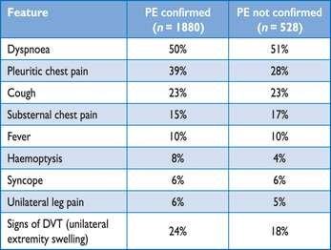
Clinical presentation

Slide 11
The revised Geneva clinical prediction rule for pulmonary embolism

Slide 12
The revised Geneva clinical prediction rule for pulmonary embolism

Slide 13
Wells score

Slide 14
diagnosis
Imaging Studies
  CXR
  V/Q Scans
  Spiral Chest CT
  Pulmonary Angiography
  Echocardiography
Laboratory Analysis
  CBC, ESR,
  D-Dimer
  ABG’s
Ancillary Testing
  ECG
  Pulse Oximetry

Slide 15
D-dimer Test
Plasmin derived fibrin degradation product.
D-dimer testing has proven to be highly sensitive but not specific.
False Positive D-Dimer
  Pregnancy
  Trauma
  Postoperative Recovery
  Inflammation
  Cancer
  Rheumatoid Factor
  Older Age
False Negative D-Dimer
  Heparin

Slide 16
ELEVATED CARDIAC BIOMARKERS
Serum troponin
Plasma heart-type fatty acid–binding protein levels increase because of RV microinfarction.
Myocardial stretch causes release of brain natriuretic peptide or NT-pro-brain natriuretic peptide.

Slide 17
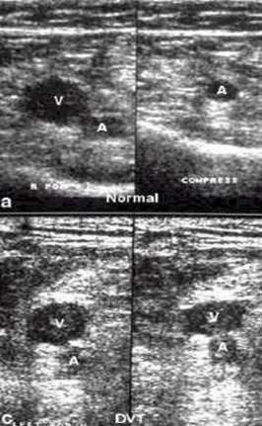
Doppler ultrasound of leg veins
Principle - Veins are normally compressible; Presence of DVT renders veins non-compressible 50% of patients with PE have positive ultrasound (95% of PE are due to leg DVT)

Slide 18
Electrocardiogram:
ECG findings in PE are generally nonspecific and includes…
Sinus tachycardia
T-wave changes
ST-segment abnormalities
Left or right axis deviation
The S1Q3T3 pattern considerd to be specific but seen in very few patients.
Other findings are:
RV dysfunction or RV strain(T-wave inversions in V1 To V3 )
RBBB

Slide 19
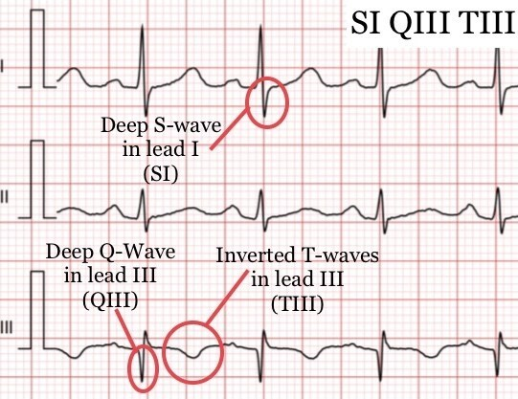
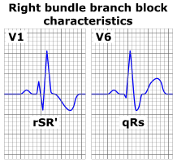

Slide 20
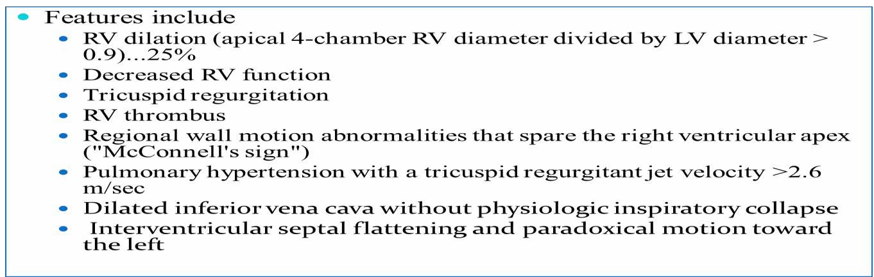
Echocardiography

Slide 21
ABG analysis
ABG has a limited role.
It usually reveal hypoxemia, hypocapnia and respiratory alkalosis.
Alveolar arterial oxygen gradient
, done at room air, a-a gradient > 15-20 is considered abnormal and it is increased in PTE.
Hypercapnia is rare.

Slide 22
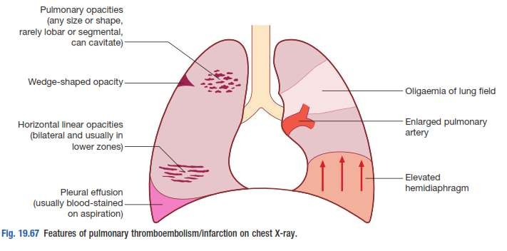
Chest x ray

Slide 23
Radiographic signs of acute pulmonary embolism
Signs with relative high specificity but low sensitivity for acute pulmonary embolism:
Decreased vascularity in the peripheral lung (Westermark sign).
Enlargement of the central pulmonary artery (Fleischner sign).
Enlarged right descending pulmonary artery (Palla's sign)
Pleural based areas of increased opacity (Hampton hump).
Hemidiaphragm elevation

Slide 24
Radiographic signs of acute pulmonary embolism
Non specific signs associated with acute pulmonary embolism that may be associated with other diseases:
Focal area of increased opacity.
Linear atelectasis.
Pleural effusion.

Slide 25
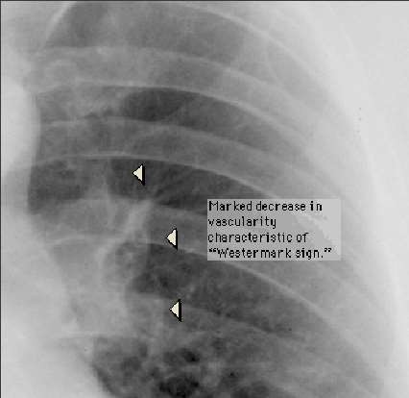
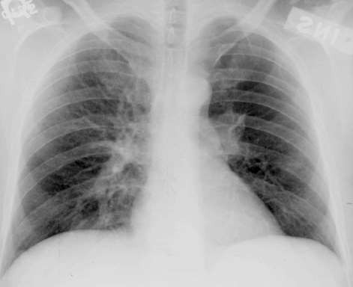
Westermark’s sign

Slide 26
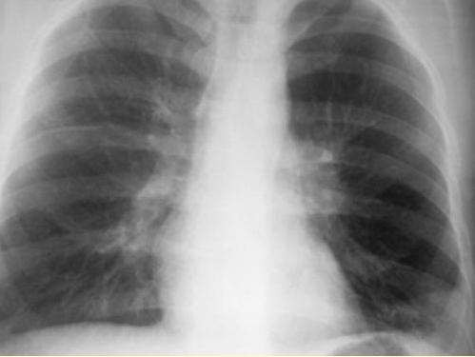
Westermark sign, with hilar enlargement
Dilatation of pulmonary vessels proximal to embolism along with collapse of distal vessels, often with a sharp cut off.

Slide 27
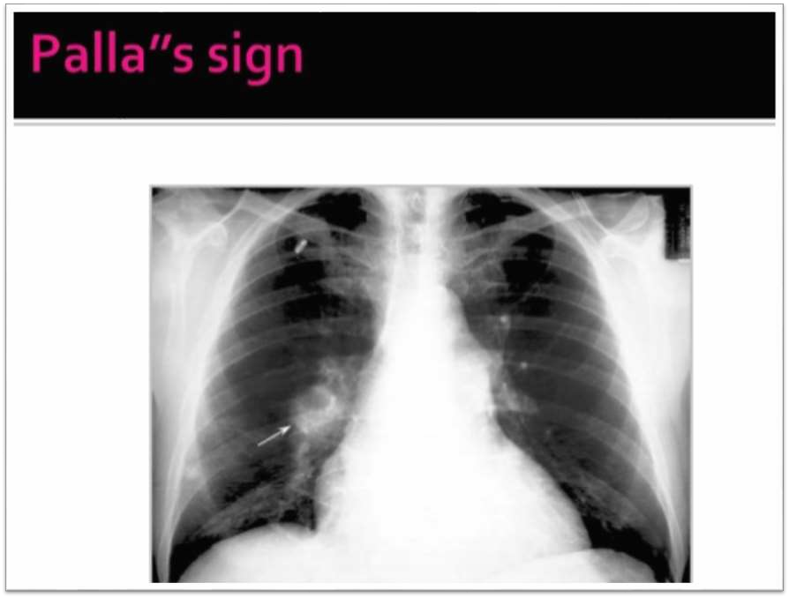

Slide 28
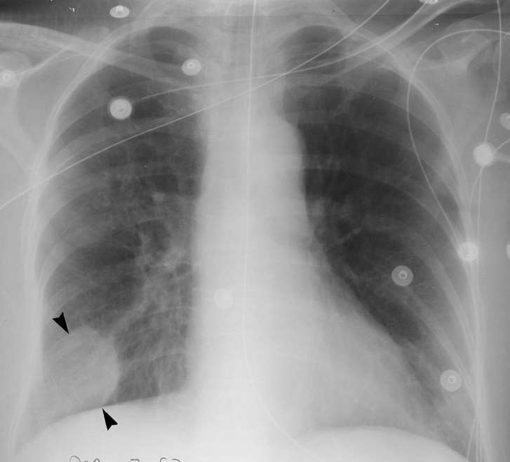
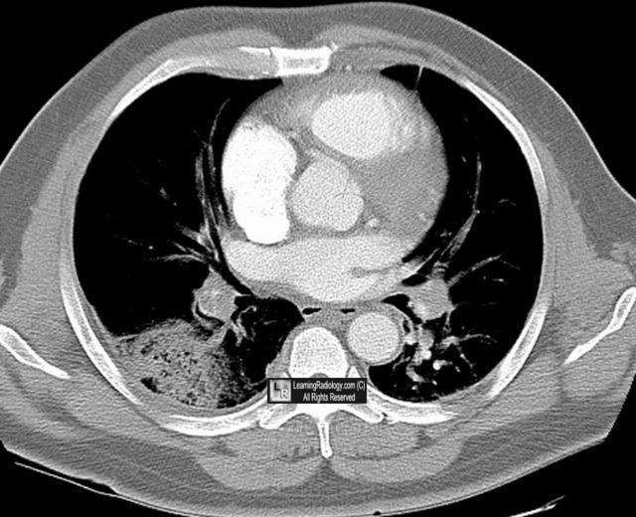
Hampton’s hump

Slide 29
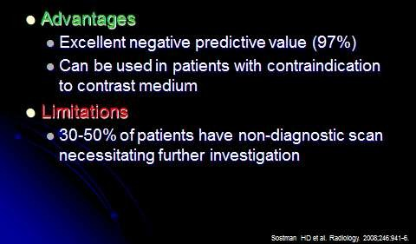
Ventilation/Perfusion Scan
- “V/Q Scan”
Preferred test in pregnant patients

Slide 30
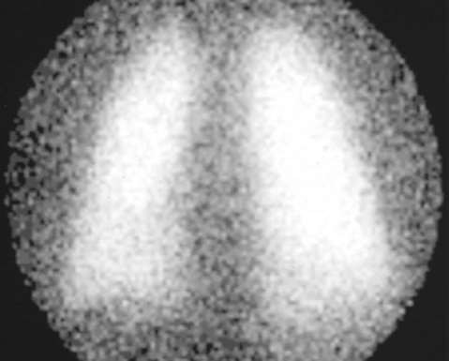
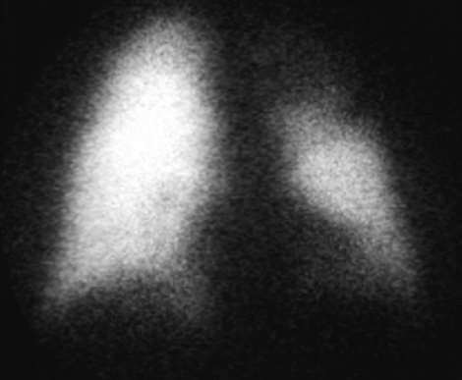
Perfusion scan
Ventillation scan
Normal Ventilation
Left UL PE

Slide 31
Spiral CT
Major advantage of Spiral CT is speed:
Often the patient can hold their breath for
the entire study, reducing motion artifacts.
Allows for more optimal use of intravenous contrast enhancement.
Spiral CT is quicker than the equivalent conventional CT permitting the use of higher resolution acquisitions in the same study time.
Contraindicated in cases of renal disease.
Sensitive for PE in the proximal pulmonary arteries, but less so in the distal segments

Slide 32
CT Angiogram
Quickly becoming the test of choice for initial evaluation of a suspected PE.
CT unlikely to miss any lesion.
Better sensitivity, specificity and can be used directly to screen for PE.
Used to follow up “non diagnostic V/Q scans.

Slide 33
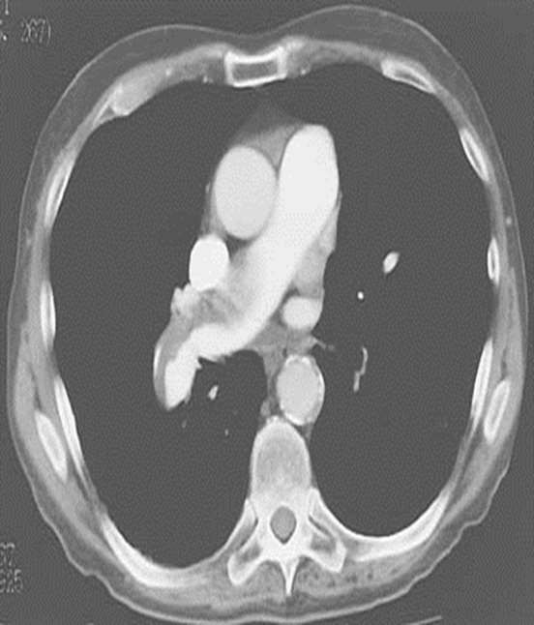

CT Angiogram
Chest computed tomography scanning demonstrating extensive embolization of the pulmonary arteries.

Slide 34
CT findings of acute pulmonary embolism
Vascular abnormalities:
Intraluminal filling defects that forms an acute angle with the vessel wall & may be surrounded by contrast material (polo mint sign or railway track sign).
Total cutoff of vascular enhancement.
Enlargement of the occluded vessel.
Ancillary findings:
Pleural based wedge shaped areas of increased attenuation with no contrast enhancement.
Linear atelectasis.

Slide 35
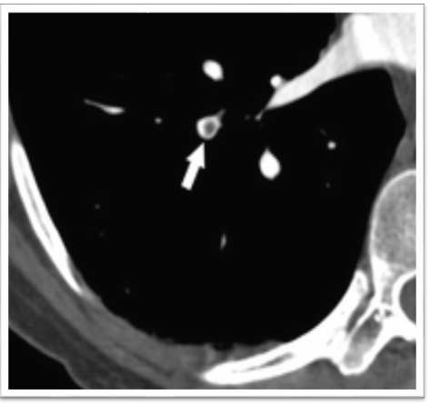
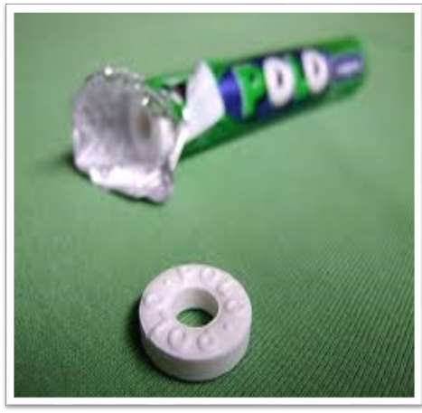
Intraluminal filling defect (polo mint sign)
Intraluminal filling defect (polo mint sign)

Slide 36
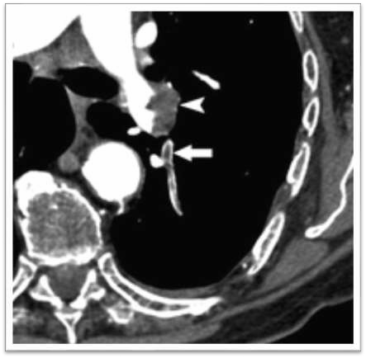
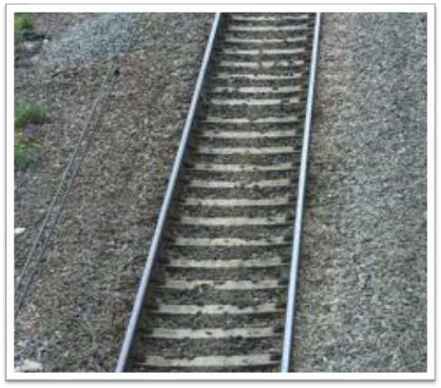
Intraluminal filling defect (railway track sign)
Intraluminal filling defect (railway track sign)

Slide 37
Pulmonary angiogram
Gold Standard.
Positive angiogram provides 100% certainty that an obstruction exists in the pulmonary artery.
Negative angiogram provides > 90% certainty in the exclusion of PE.
  “Court of Last Resort”

Slide 38
Further Alternative Imaging Tests
Dual-energy CTPA
Electrocardiographically gated CTPA
Three-dimensional images acquired by single- photon emission computed tomography (SPECT) using a gamma-emitting radioisotope may improve V/Q scintigraphy and has a lower radiation dose.
MR angiography

Slide 39
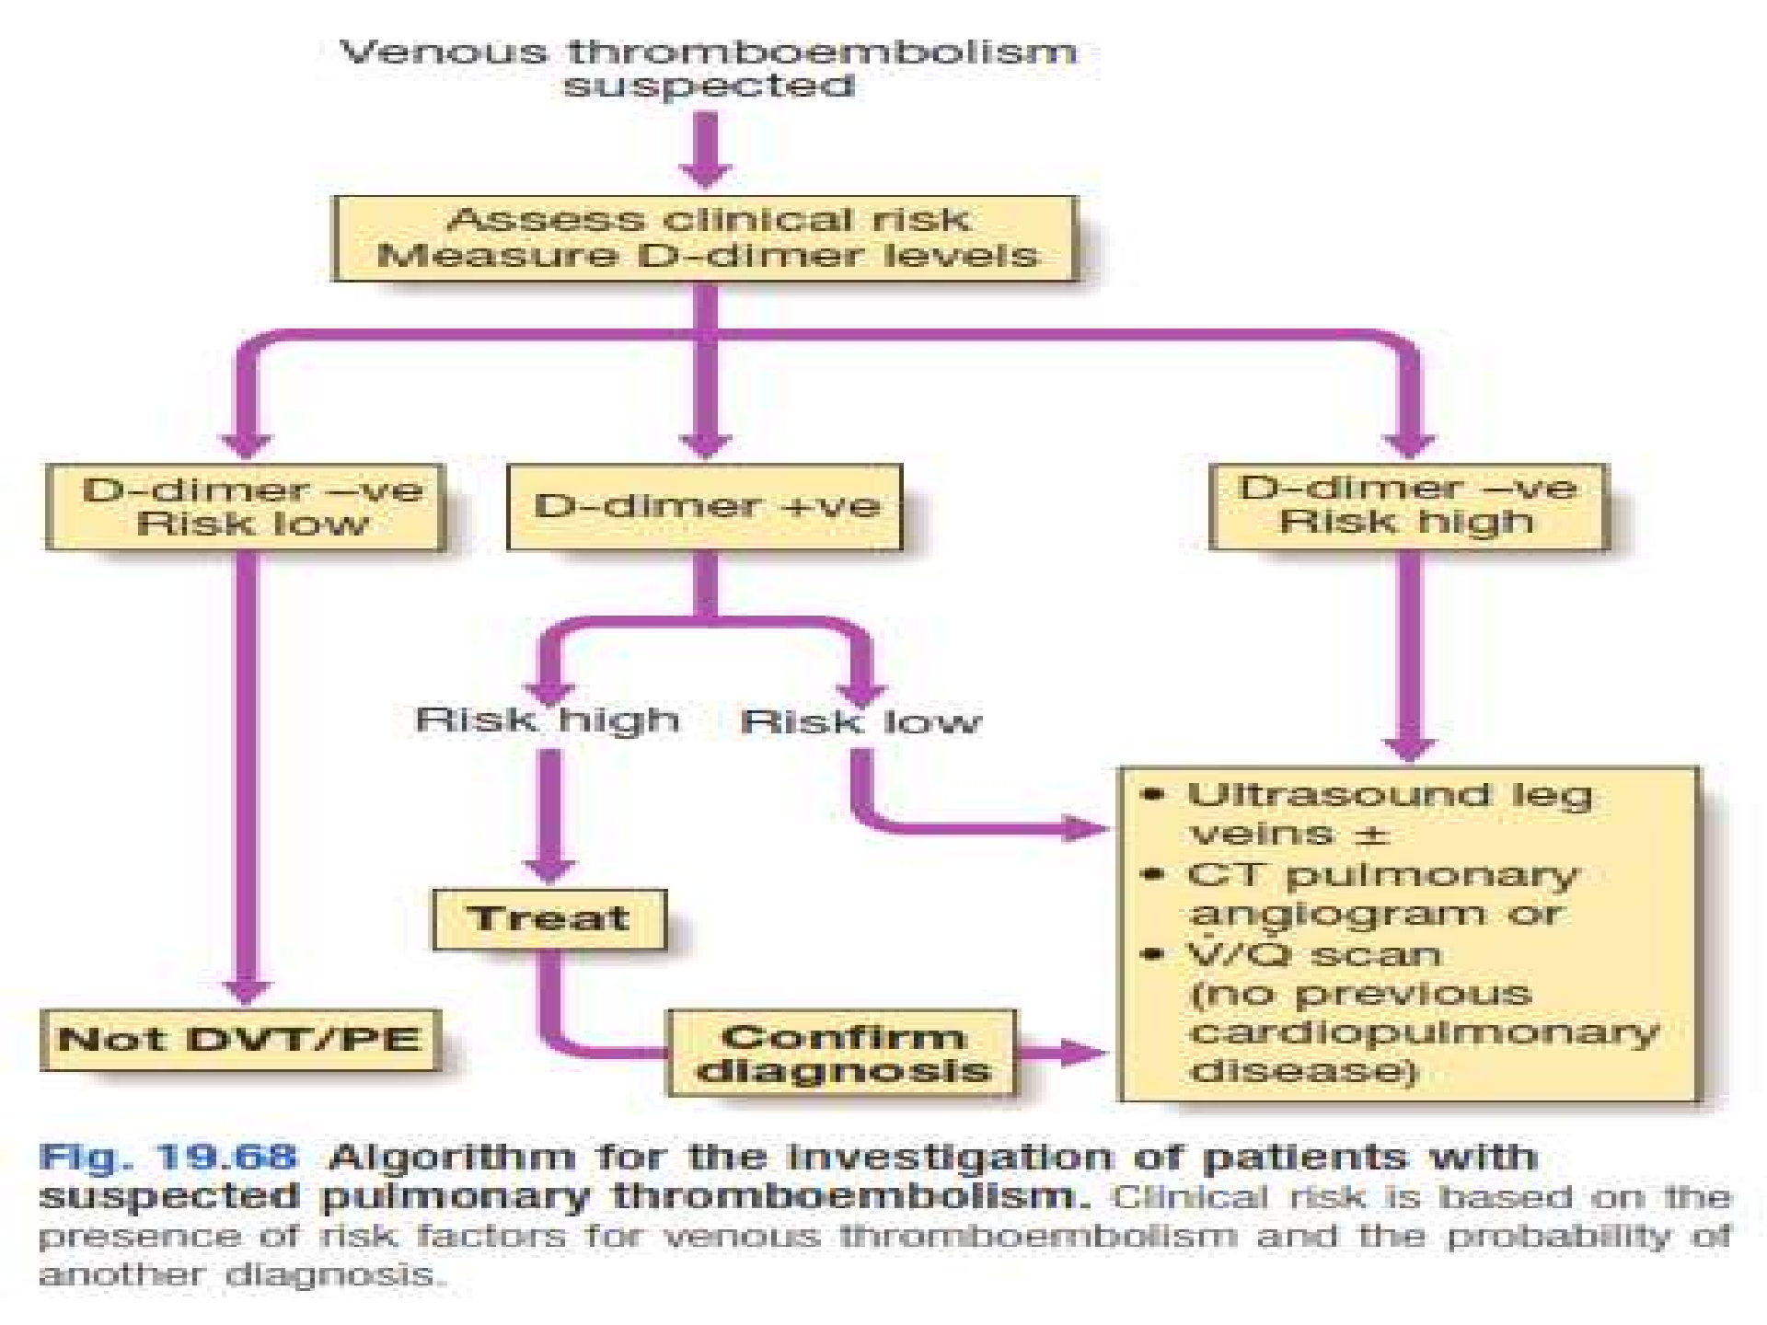

Slide 41
Treatment
Symptomatic treatment:
  Oxygen
  Analgesia
Anticoagulation:
  IV Heparin
  S/C LMWH eg Enoxaparine, Dalteparine
  Oral Warfarin
IVC filter: If there is contra-indications for anti-coagulation
Thrombolysis: tPA eg Alteplase, Tenectaplase
Surgical procedures: Pharmacomechanical catheter directed therapy, pulmonary embolectomy

Slide 45
Thrombolytic therapy:
Direct lysis of trombi by increasing plasmin production through plasminogen activation.
Relatively high incidence of hemorrhagic complications.
Streptokinase,alteplase(rt-pa) and urokinase all are FDA approved drugs for managementof PE.
The PEITHO(pulmonary embolism thrombolysis) trial will evaluate the efficacy andsafety of tenecteplase in normotensive patients with evidence of RV dysfuntion.
Intracranial hemorrhage hasoccured in 0.5%to 3% ofpatients treated with the thrombolytic agents in both PE and MI.

Slide 46
PULMONARY EMBOLECTOMY
Consider surgical embolectomy:
Patients with persistent hypotension, shock, or cardiac arrest
Who either failed thrombolysis or have a contraindication to thrombolytic management.

Slide 49
Thank you

